Slide 1

Portfolio Entry 2
Advisor: Mrs. Campbell
Deadline: April 24th, 2020
Antoine Gagne

Slide 2

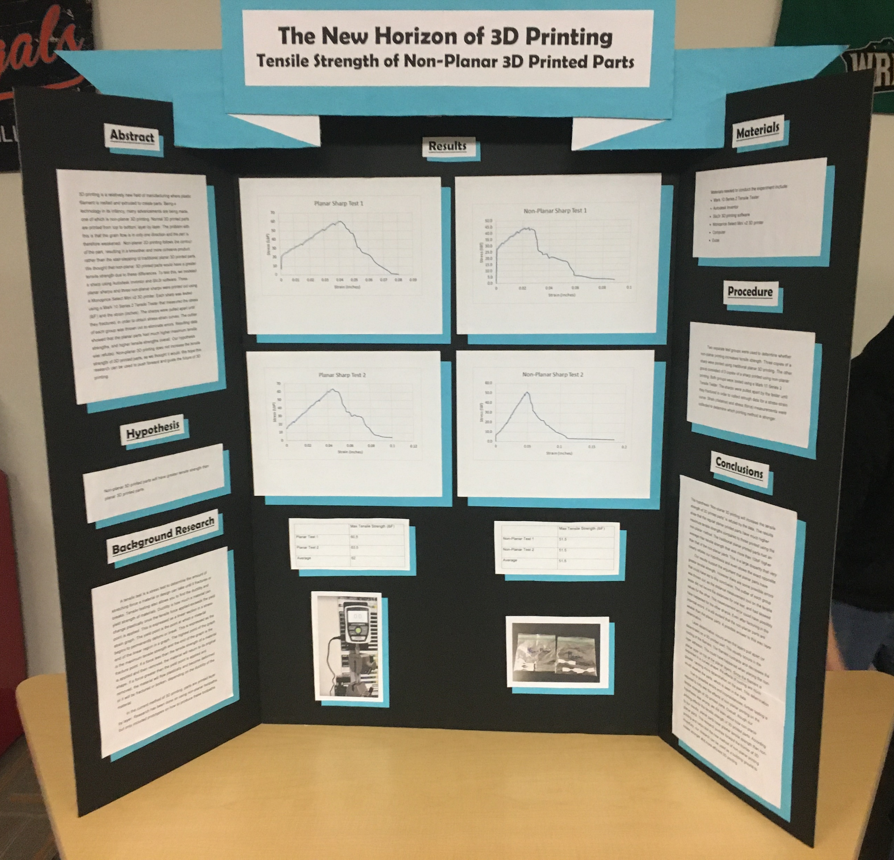
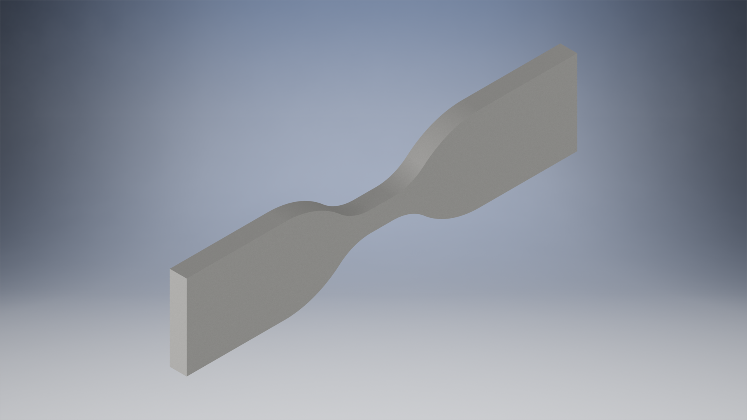
First Project Science Fair
Science Fair Board (left) and Tensile Test Dumbbell (Right)
Completed on: February 8th, 2020

Slide 3
Project Description Science Fair
This year for science fair, I decided to test the tensile strength of 3D printed parts. Through this project, I was introduced to the career field of material science. The project I did involved both material science and 3D printing. My partner and I found a method of 3D printing that we thought would increase the tensile strength of the 3D printed parts. We 3D printed tensile strength dumbbells, half were printed using regular techniques, and the others were made with the new technique. Though our hypothesis was wrong, I learned a lot about material science. The thing that kick off my interest in material science was a visit to a heat treating facility with my dad. This inspired me to do this science fair project. After this project, my interest in material science has grown a lot.

Slide 4
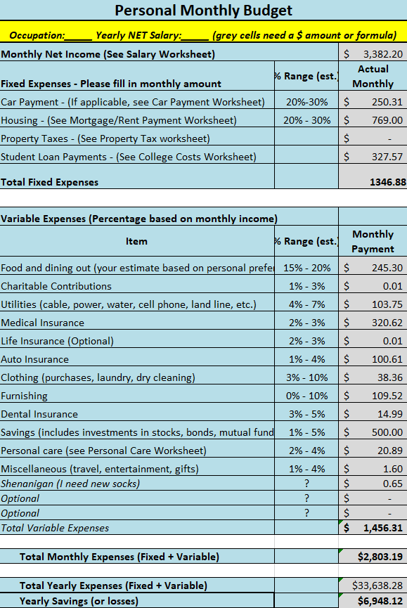
Second Project Budgeting project
Screenshot of final breakdown of my budget from the project
Completed on: October 11th, 2019

Slide 5
Project Description Budgeting Project
During the Budgeting Project, I demonstrated my readiness not only for my future career, but also my adult life. The Budgeting Project was a project done in Financial Literacy meant to prepare us in terms of creating, managing, and maintaining a budget for our “future” lives. For this project, I chose to be an engineer for Lockheed Martin in Dallas, Texas. I went to college at Wright State University, and got a bachelors in engineering. In my future career, I want to be an engineer and designer (If I had to choose what I would design, it would probably be tooling and fixturing). Budgeting is an important skill to have, because you need to be able to design and test components within the budget of your client. Overall, I believe this project helped me develop an important skill for my future career.

Slide 6
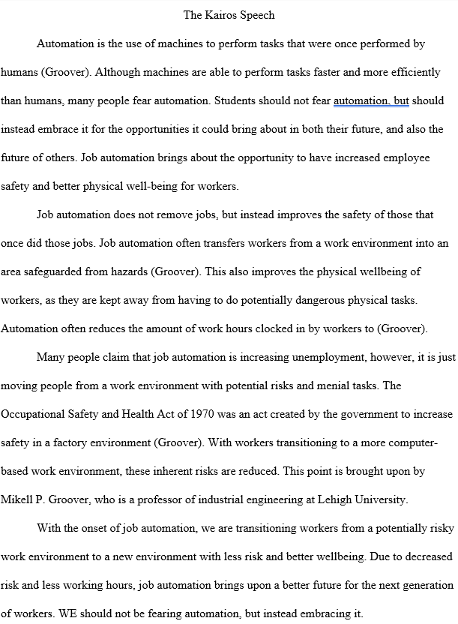
Third Project Kairos Speech
Full Script for the Kairos Speech Written by Antoine Gagne (Me)
Completed on: March 26th, 2020

Slide 7
Project Description Kairos Speech
For the Kairos Speech Project, I believe that I demonstrated the ability of clearly presenting an idea or solution to an audience. In my future career as an engineer/designer, I need to be able to clearly present my designs, or ideas to solve a problem. This project helped me a lot, as for this project, we needed to prepare a presentation explaining an issue to an intended audience (in this case, students in our grade). I decided to do mine on job automation, as I believe that it is a good thing, but many people are against it. Due to the Coronavirus situation, we had to do a recording of our presentation instead of presenting to the class. Overall, I believe that this project prepared me in terms of preparing a presentation to explain to others the pros and cons of certain situations or solutions.

